Slide 1
Exploring the relationship between age and health.
Laurie Narcisse

Slide 2
Question?
Are patients who have arthritis more likely to be over 40, and how many of them have had high blood pressure and a stroke?

Slide 3
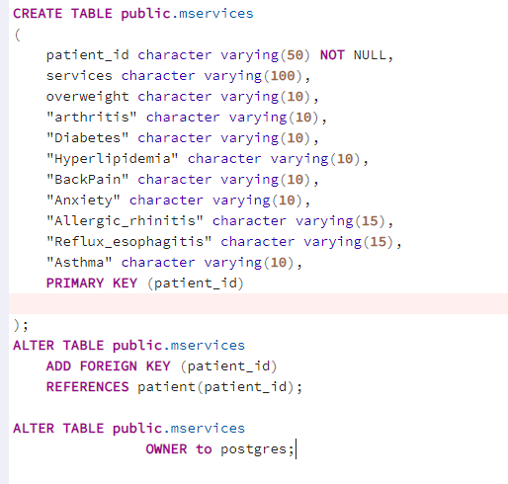
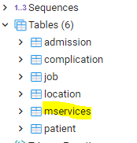
Create Table

Slide 4
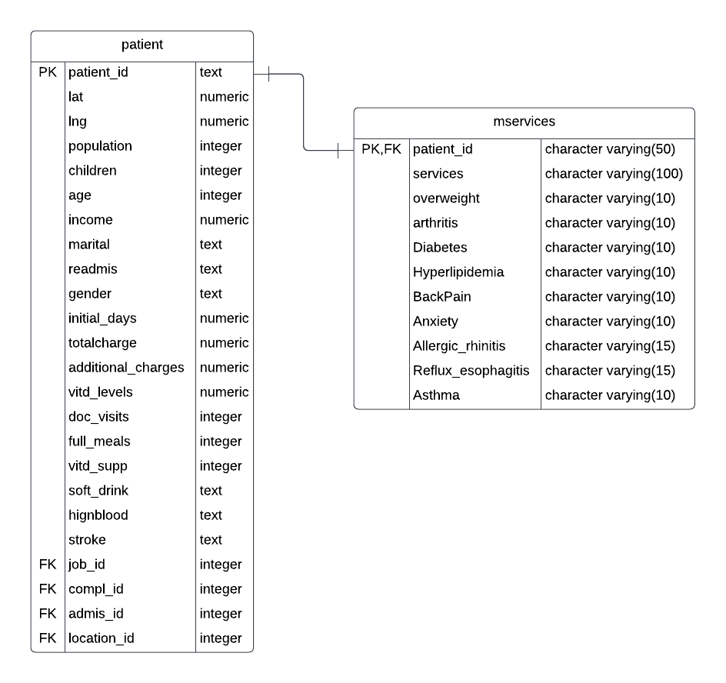
ERD DIAGRAM

Slide 5
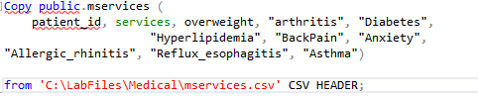

IMPORT
Instead of Import/Export we can use the SQL above to load the CSV.

Slide 6

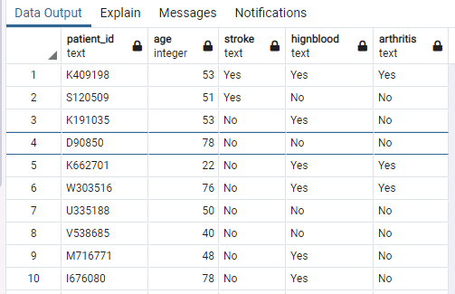
The research question looks at the relationship between the number of patients over 40 who had arthritis and whether they had high blood pressure and a stroke. The query below is used to generate a dataset that includes the fields used from both tables.

Slide 7
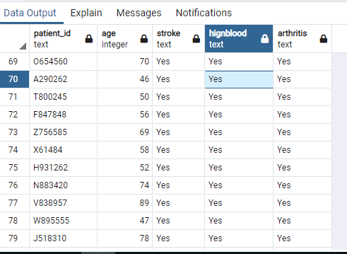
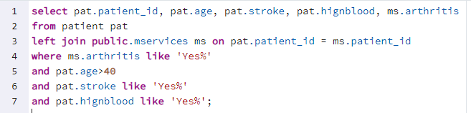
Question Answered by Query

Slide 8
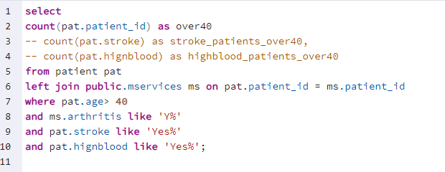
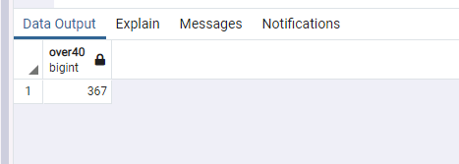
COUNT

Slide 9
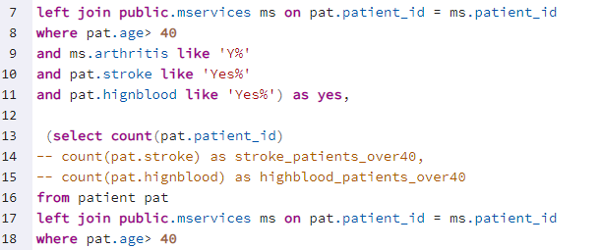

Compare
There are fewer patients over 40 who have arthritis, high blood pressure and had a stroke.

